Slide 1

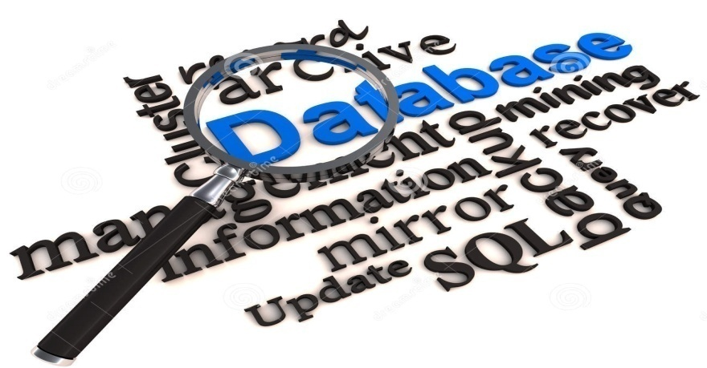
Hardik Doshi
Roll no. :- 05
Advantage & Disadvantage Of Data Base Management System..

Slide 2
Advantage
Of
DBMS

Slide 3
Redundancy can be controlled:
Database Management System prevents the same data to appear more than one time. It means it saves Memory.
Data Can be shared:
Once data is stored and managed in database then using Network data can be used by multiple users at same time.
Standards can be enforced:
Data are standardized in DBMS and data stored are passed through that particular set of rules and regulations. It means data are consistent.

Slide 4
Security:
DBMS secures data easily with passwords and encryption-decryption methods to save data from malicious users.
Data Integration:
Data in database are related / integrated to each other and this integrity of the data can be maintained in DBMS.

Slide 5
Easy to Manipulate:
Data in DBMS are easy to manipulate, It means It is easy to Insert – Update or Delete data from the database.
Helps in Decision Making :
Data in database are well-managed and organized and thus it helps Management professionals to take decision from analyzing organized data.

Slide 6
Disadvantage
Of
DBMS

Slide 7
Disadvantages of DBMS
Complexity
Size
Cost of DBMS
Additional hardware costs
Performance
Higher impact of a failure
Malicious use / Hacking

Slide 8

- Hardik Doshi

